Slide 1
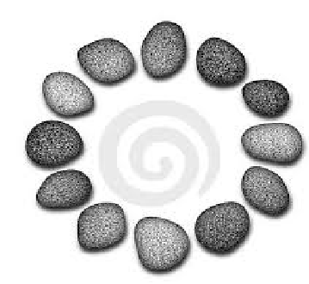

Password Hashing and Graph Pebbling
Samson Zhou
Joint work with:
Jeremiah Blocki, Ben Harsha, Ling Ren

Slide 2
Structure of Talk
Economics of Password Hashing
Graph Pebbling and Evaluations
Computability of Graph Pebbling

Slide 3
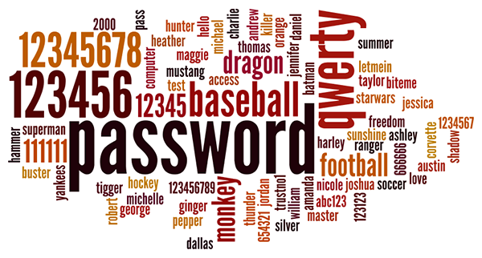
Background
Users tend to pick weak passwords

Slide 4
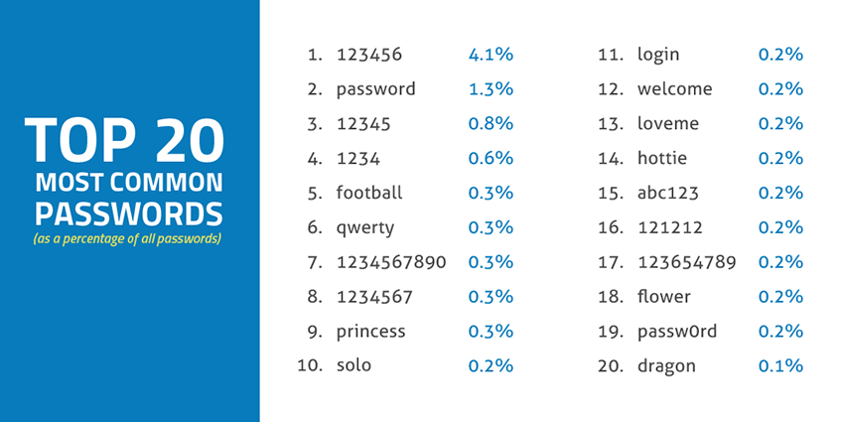
Source: SkyHigh

Slide 5

Background
Users tend to pick weak passwords
Server attacks are inevitable

Slide 6
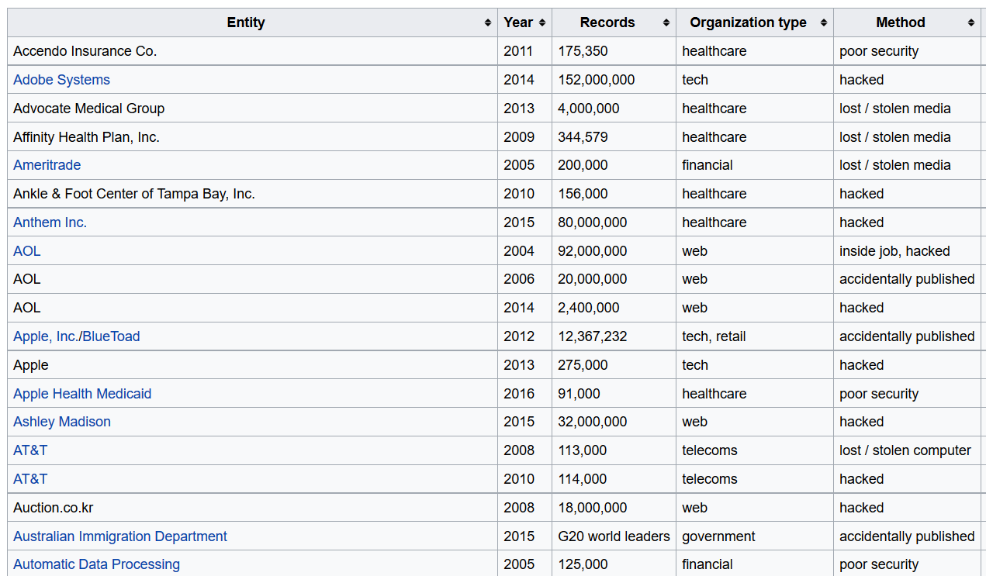

Slide 7
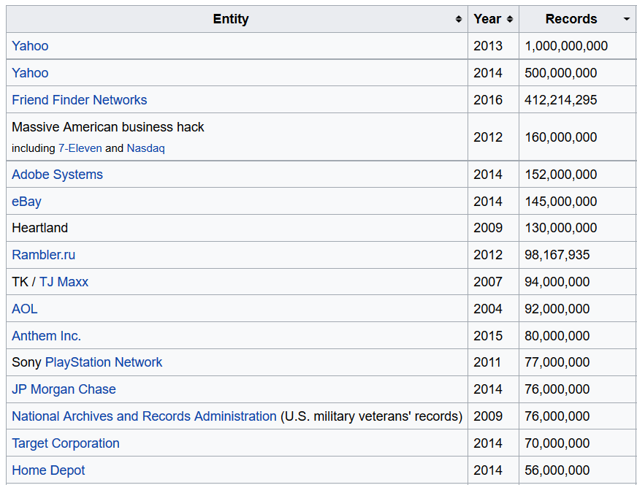

Slide 8












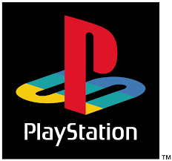


Slide 9





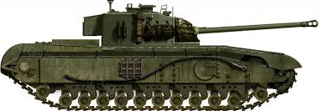

Slide 10
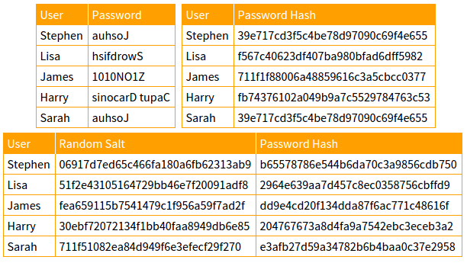

Slide 11
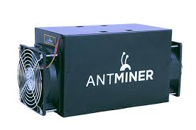
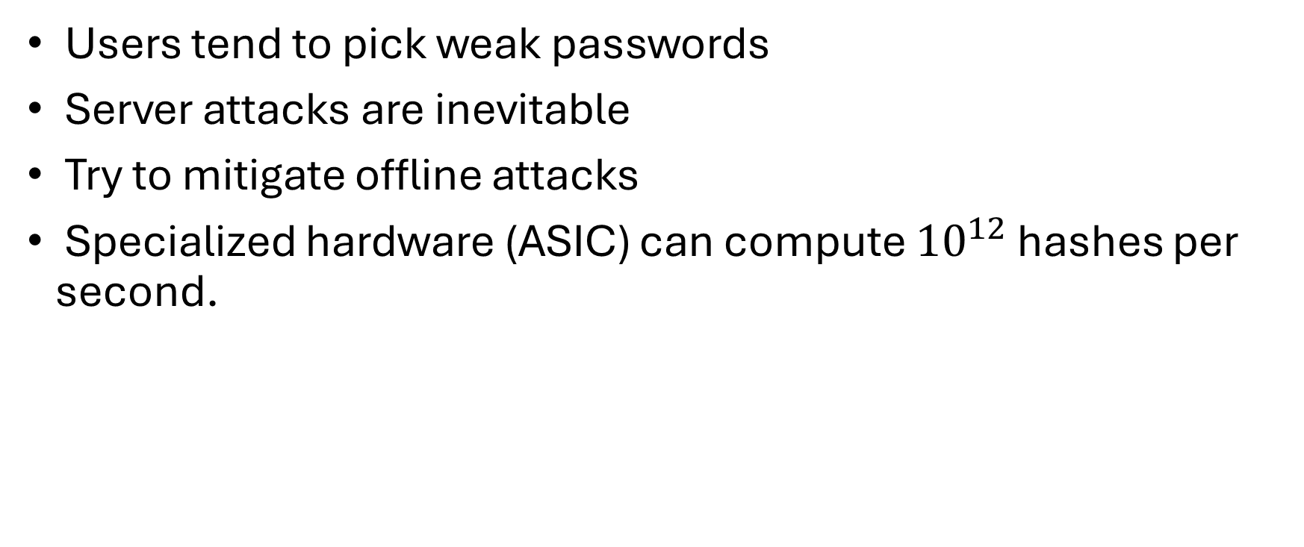
Motivation
Users tend to pick weak passwords
Server attacks are inevitable
Try to mitigate offline attacks
Specialized hardware (ASIC) can compute ${10}^{12}$ hashes per second.

Slide 12

Password Hash Function Goals
“Moderately Expensive” to compute
Expensive to compute on ASIC
Fast and cheap on PC

Slide 13



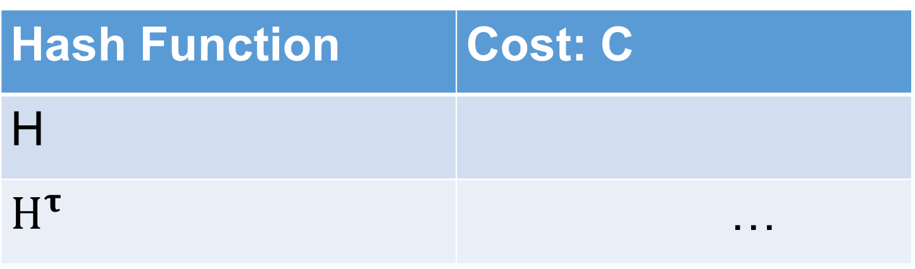
Key Stretching
Hash Function | Cost: C
H
$H^{τ}$ | …
Hash Iteration
Memory Hard Functions
PBKDF2

Slide 14
Strong Claims (Post Breaches)
“Cracking our algorithms [PBKDF2-SHA256] is extremely difficult, even for the strongest of computers.” – LastPass Blog
“The bcrypt hashing algorithm protecting it is very resilient to cracking and frankly, all but the worst possible password choices are going to remain secure even with the breach now out in the public…”
Can we predict how many users passwords a rational attacker will crack after a breach?

Slide 15
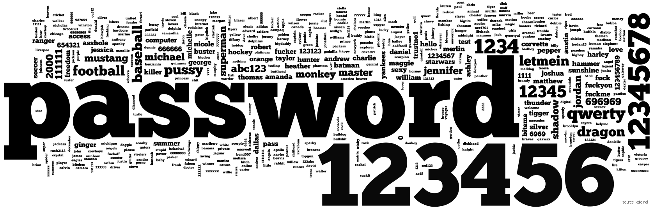

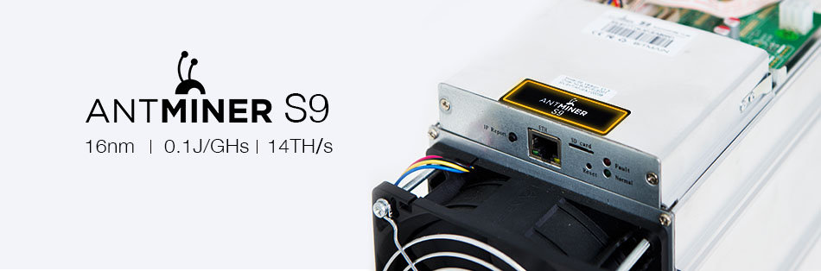
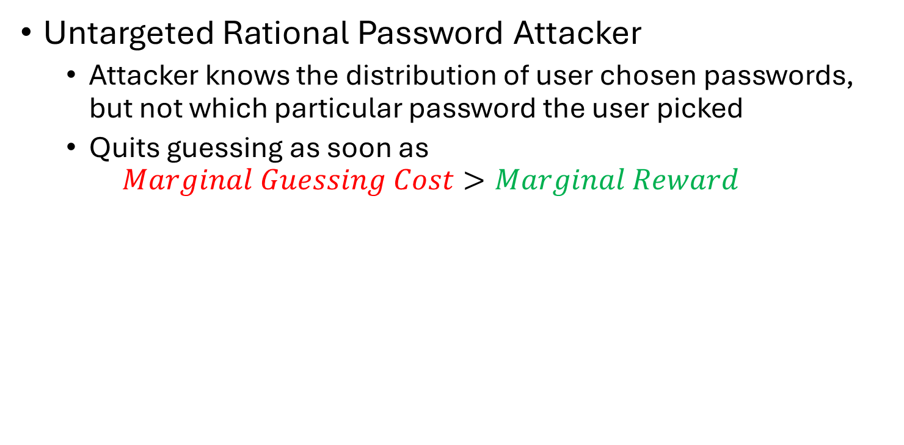
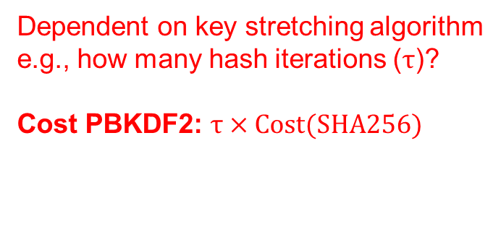
Decision Theoretic Model
Untargeted Rational Password Attacker
Attacker knows the distribution of user chosen passwords, but not which particular password the user picked
Quits guessing as soon as
$$Marginal Guessing Cost>Marginal Reward$$
Dependent on key stretching algorithm
e.g., how many hash iterations ($τ$)?
Cost PBKDF2: $τ×Cost(SHA256)$
$1,200

Slide 16
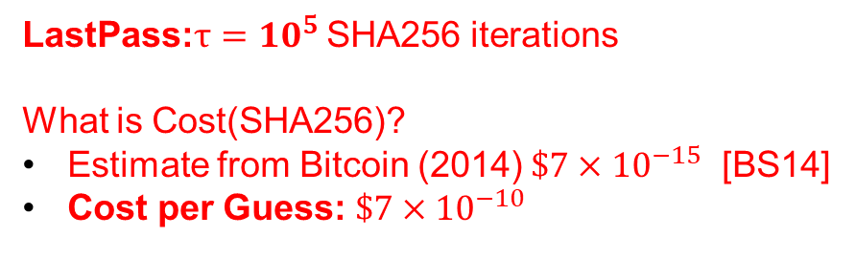
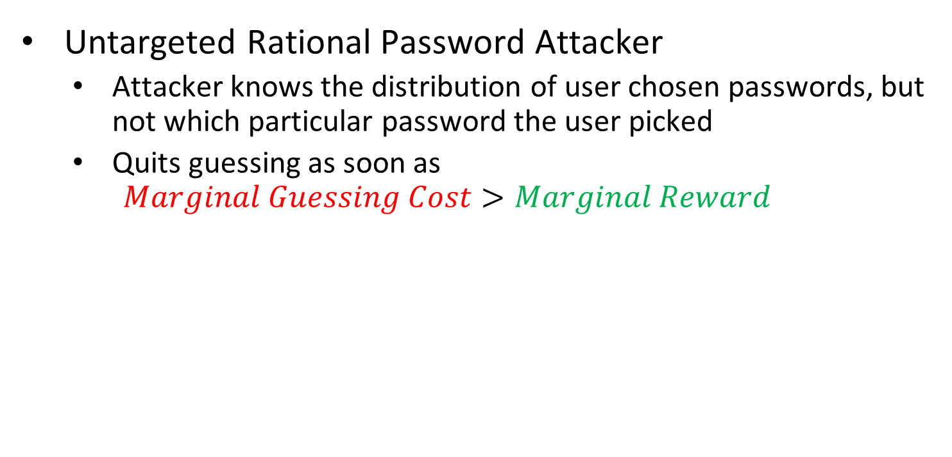
Decision Theoretic Model
Untargeted Rational Password Attacker
Attacker knows the distribution of user chosen passwords, but not which particular password the user picked
Quits guessing as soon as
$$Marginal Guessing Cost>Marginal Reward$$
LastPass:$τ={10}^{5}$ SHA256 iterations
What is Cost(SHA256)?
Estimate from Bitcoin (2014) $\$7×{10}^{−15}$ [BS14]
Cost per Guess: $\$7×{10}^{−10}$
$1,200

Slide 17
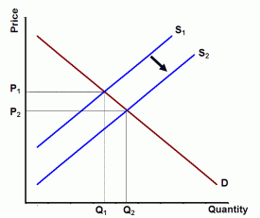

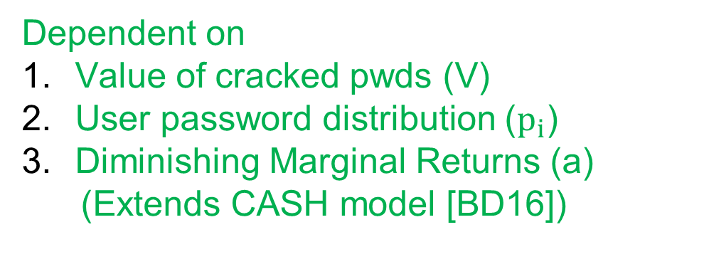
Decision Theoretic Model
Untargeted Rational Password Attacker
Attacker knows the distribution of user chosen passwords, but not which particular password the user picked
Quits guessing as soon as
$$Marginal Guessing Cost>Marginal Reward$$
Dependent on
Value of cracked pwds (V)
User password distribution ($p_{i}$)
Diminishing Marginal Returns (a)
(Extends CASH model [BD16])

Slide 18
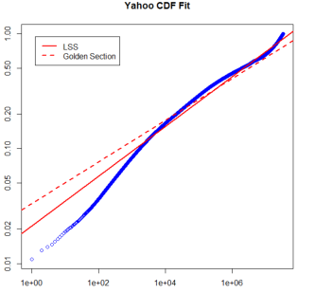
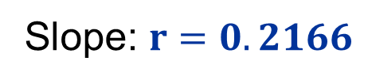

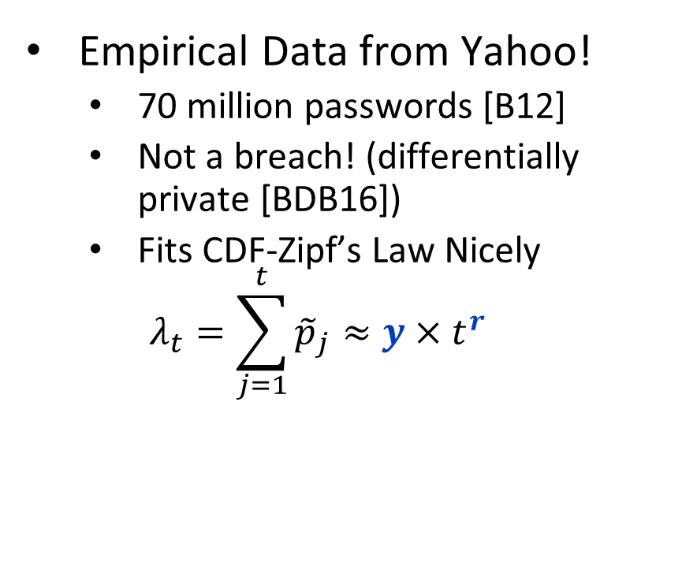
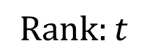
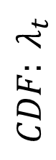
User Password Distribution
Empirical Data from Yahoo!
70 million passwords [B12]
Not a breach! (differentially private [BDB16])
Fits CDF-Zipf’s Law Nicely
$$λ_{t}=\sum_{j=1}^{t}{{\tilde{p}}_{j}}≈y×t^{r}$$
$${CDF: λ}_{t}$$
Slope: $r=0.2166$
$$y=0.0211$$
$$Rank:t$$

Slide 19
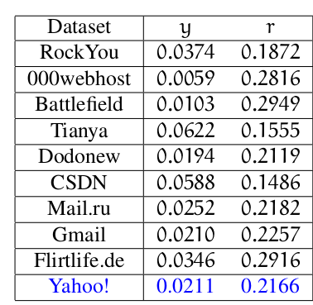

User Password Distribution
Empirical Data from Yahoo!
70 million passwords [B12]
Not a breach! (differentially private [BDB16])
Fits CDF-Zipf’s Law Nicely
$$λ_{i}=\sum_{j=1}^{i}{{\tilde{p}}_{j}}≈y×t^{r}$$
Consistent with previous findings on smaller breached datasets
Wang et al. [WCWHJ17]
Our Result: CDF-Zipf’s Law Parameters (y,r) for Yahoo!

Slide 20
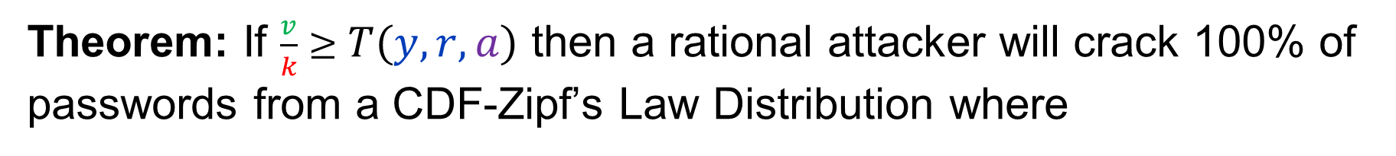
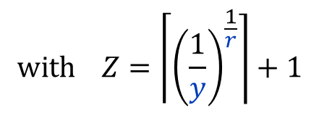
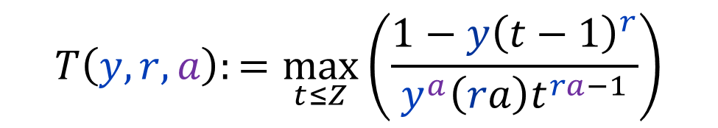
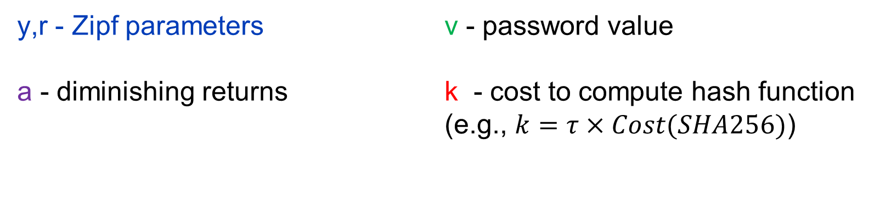
Threshold Function of Doom
Theorem: If $\frac{v}{k}≥T\left(y,r,a\right)$ then a rational attacker will crack 100% of passwords from a CDF-Zipf’s Law Distribution where
$$T\left(y,r,a\right):=\max_{t≤Z}\left(\frac{1−y{\left(t−1\right)}^{r}}{y^{a}{\left(ra\right)t}^{ra−1}}\right)$$
$$with Z=\left\lceil {\left(\frac{1}{y}\right)}^{\frac{1}{r}}\right\rceil +1$$
y,r - Zipf parameters
a - diminishing returns
v - password value
k - cost to compute hash function (e.g., $k=τ×Cost(SHA256)$)

Slide 21
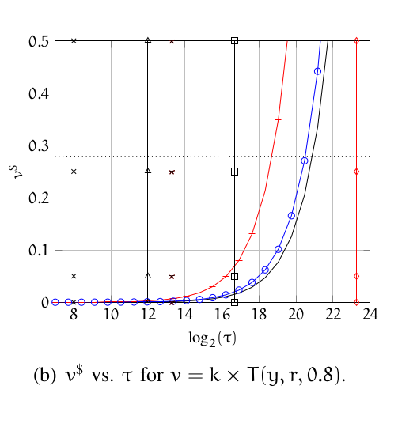
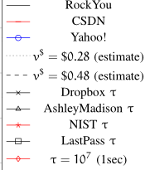
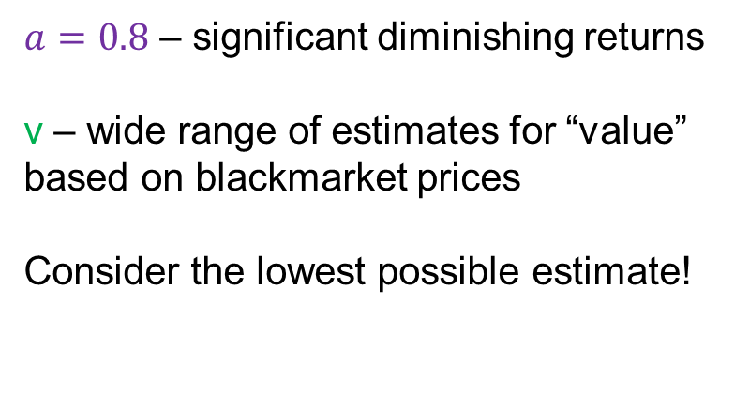
An “Optimistic” Picture
$a=0.8$ – significant diminishing returns
v – wide range of estimates for “value” based on blackmarket prices
Consider the lowest possible estimate!
DOOM ZONE
NIST Recommendations
LastPass

Slide 22
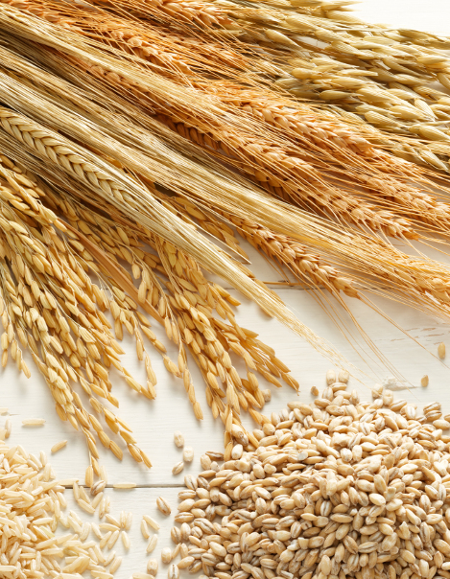
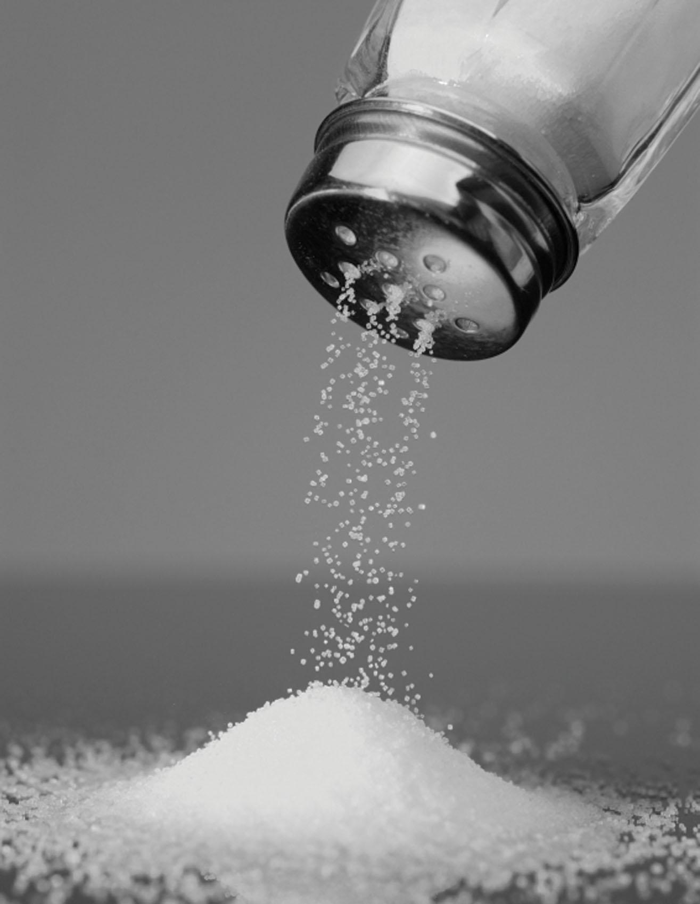
A Grain of Salt
Even if we make no assumptions about the shape of the password distribution, we can still argue that the attacker cracks most passwords with high probability.
(Chernoff Bounds)
While CDF-Zipf’s law fits empirical datasets nicely, we cannot be certain that it models the tail of the distribution.
At minimum attacker cracks all passwords that do follow Zipf’s Law (it is possible that some passwords from the tail of the distribution won’t be cracked)
How big is the tail of the distribution?
LinkedIn: Only 14% of passwords unique.
Source: https://www.troyhunt.com/86-of-passwords-are-terrible-and-other-statistics/

Slide 23
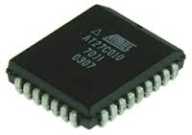
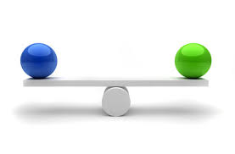


Slide 24
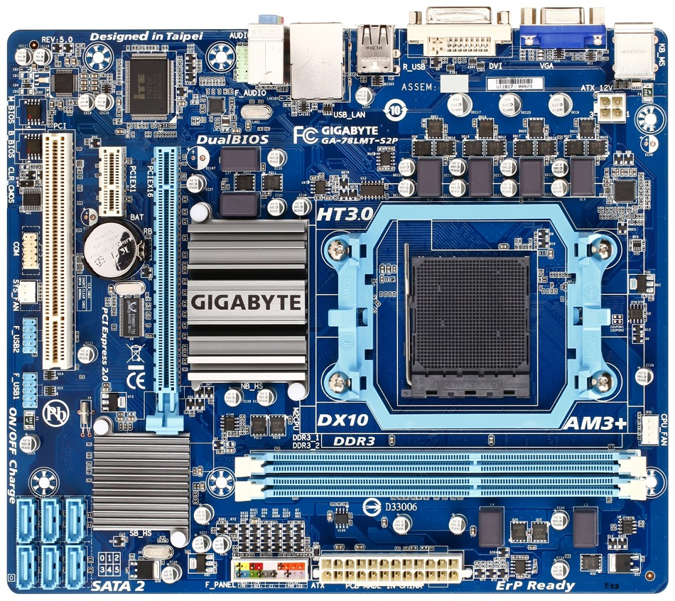
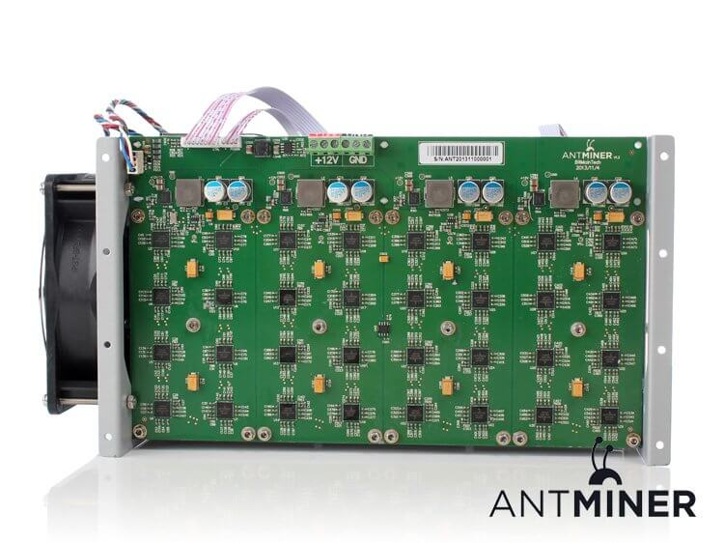

Slide 25
Memory Hard Functions
Memory hard functions require comparatively more resources for adversaries to compute
Data-dependent memory hard functions are susceptible to side-channel attacks
Data-independent memory hard functions (iMHFs)

Slide 26
iMHFs
$$f_{G,H}$$
Hash function: $H$

Slide 27
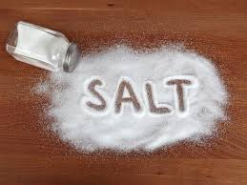
iMHFs
$$f_{G,H}$$
pwd
$$h_{1}$$
$$h_{1}=H(pwd, salt)$$

Slide 28
iMHFs
$$f_{G,H}$$
pwd
$$h_{1}$$
$$h_{2}$$
$$h_{2}=H(h_{1})$$

Slide 29
iMHFs
$$f_{G,H}$$
pwd
$$h_{1}$$
$$h_{2}$$
$$h_{3}$$
$$h_{4}$$
$$h_{3}=H\left(h_{1},h_{2}\right), { h}_{4}=H(h_{2})$$

Slide 30
iMHFs
$$f_{G,H}$$
pwd
$$h_{1}$$
$$h_{2}$$
$$h_{3}$$
$$h_{5}$$
$$h_{4}$$
$$h_{5}=H\left(h_{3},h_{4}\right)$$

Slide 31
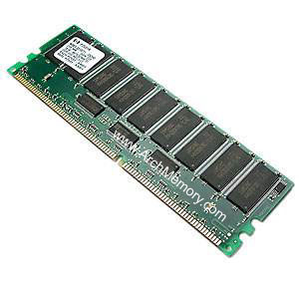


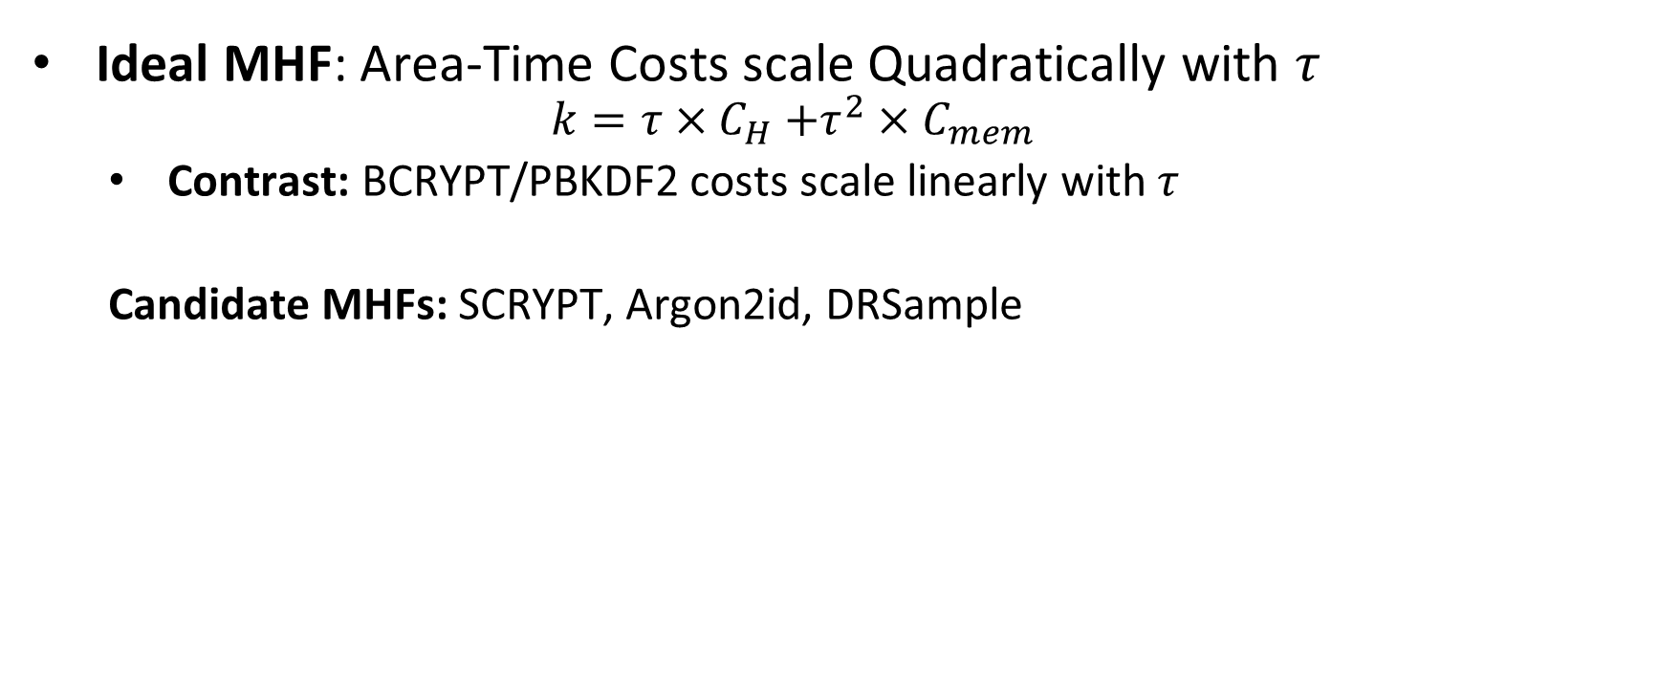
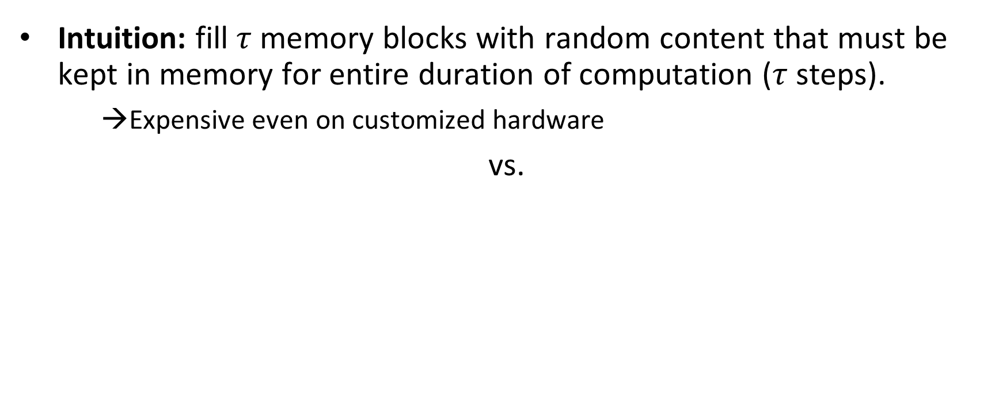
Memory Hard Functions (MHF)
Intuition: fill $τ$ memory blocks with random content that must be kept in memory for entire duration of computation ($τ$ steps).
→Expensive even on customized hardware
vs.
Ideal MHF: Area-Time Costs scale Quadratically with $τ$
$$k=τ{×C}_{H}+τ^{2}×C_{mem}$$
Contrast: BCRYPT/PBKDF2 costs scale linearly with $τ$
Candidate MHFs: SCRYPT, Argon2id, DRSample
Notes:
In this work we study a special type of memory hard function called data-independent memory hard functions. As the name suggests the memory access pattern will not depend on the input making the functions resistant to side-channel attacks.

Slide 32
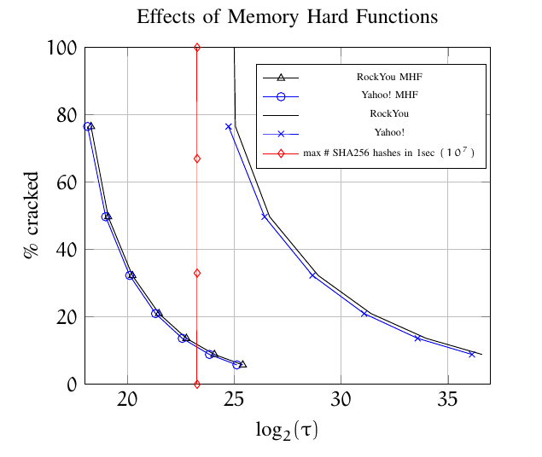
MHFs Are Helpful
“Pessimistic” Analysis
a=1
No Diminishing Marginal Returns (a=1)
v=$4
Value of cracked password is order of magnitude higher than in previous analysis
Quadratic Scaling: Less time required to give the same protection!
MHF: ~250ms
Non-MHF:~2 minutes

Slide 33


Executive Summary of Our Findings
BCRYPT/PBKDF2 provide insufficient protection for most user passwords!
Memory Hard Functions provide much stronger protection
SCRYPT, Argon2id, DRSample

Slide 34
Recommendations for Users
Enable Two-Factor Authentication
Focus energy on selecting different passwords for different accounts (as opposed to selecting more complex passwords)
Write down (part of) your passwords?
Example: (TAMU, szhou, ______3jtph$)

Slide 35
Structure of Talk
Economics of Password Hashing
Graph Pebbling and Evaluations
Computability of Graph Pebbling

Slide 36
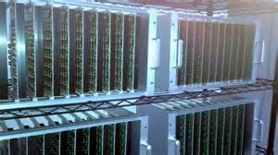

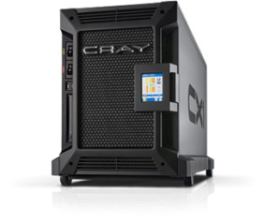




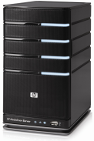
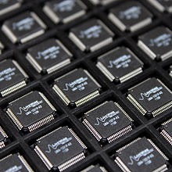
Goal: Moderately Expensive Hash Function
Fast on PC and
Expensive on ASIC?
Notes:
This motivates the need for moderately hard functions. The basic idea is to build a password hash function that is moderately expensive to compute to limit the number of guesses that an adversary would be willing to try. An honest server only needs to compute the function once during a typical authentication session. However, the adversary potentially has an advantage in this game. While the honest server must typically evaluate the function on standard hardware, the adversary could use potentially reduce the cost per password guess by developing customized hardware (GPUs, FPGAs, ASICs) to evaluate the password hash function. Thus, we want to ensure that the cost to evaluate this function is equitable across platforms.

Slide 37

(2013-2015)
https://password-hashing.net/

Slide 38

We recommend that you use Argon2…
(2013-2015)
https://password-hashing.net/

Slide 39
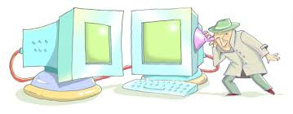
We recommend that you use Argon2…
There are two main versions of Argon2, Argon2i and Argon2d. Argon2i is the safest against side-channel attacks
(2013-2015)
https://password-hashing.net/

Slide 40
Argon2i
…
1
2
3
4
i
n

Slide 41
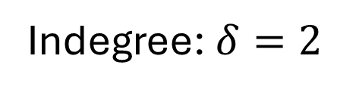
Argon2i
random predecessor r(i) < i
…
1
2
3
4
i
n
Indegree: $δ=2$
Argon2iA (v1.1): Uniform Distribution
Argon2iB (v1.2+): Non-Uniform

Slide 42
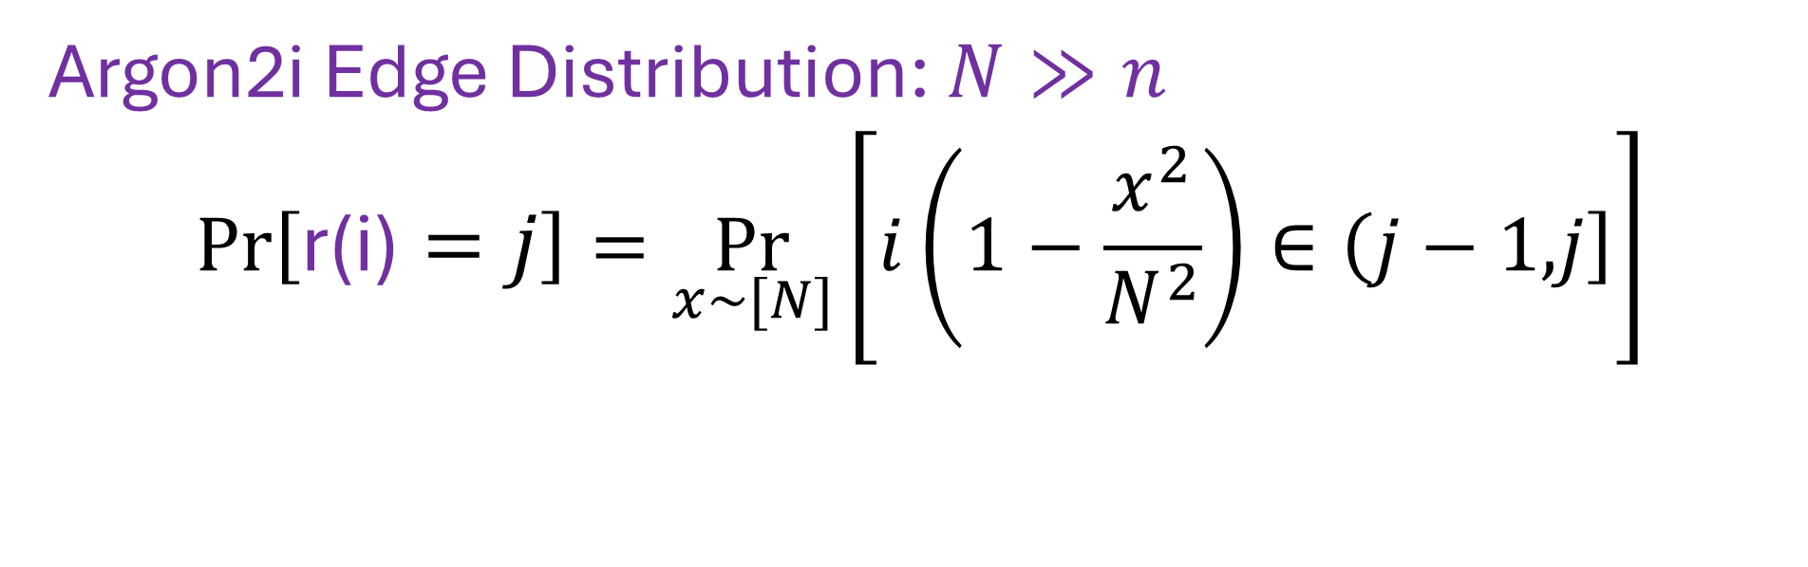

Argon2i
…
…
…
1
2
i-8
i-4
i-4
i-3
i-2
i-1
i
n
Indegree: $δ=2$
r(i)
Argon2i Edge Distribution: $N≫n$
$$Pr\left[\text{r}\text{(}\text{i}\text{)}=j\right]=\underset{x\sim [N]}{Pr}\left[i\left(1−\frac{x^{2}}{N^{2}}\right)∈\left(j−1,\right.\left.j\right]\right]$$

Slide 43
Argon2i
$$Closer Nodes receive more weight$$
…
…
…
…
…
1
2
i-8
i-4
i-4
i-3
i-2
i-1
i
n
Indegree: $δ=2$
r(i)
Argon2i Edge Distribution: $N≫n$
$$Pr\left[\text{r}\text{(}\text{i}\text{)}=j\right]=\underset{x\sim [N]}{Pr}\left[i\left(1−\frac{x^{2}}{N^{2}}\right)∈\left(j−1,\right.\left.j\right]\right]$$

Slide 44

Argon2i
$$Pr\left[\text{r}\text{(}\text{i}\text{)}=1\right]=Ω\left(\frac{1}{i}\right)$$
$$Closer Nodes receive more weight$$
…
…
…
1
2
i-8
i-4
i-4
i-3
i-2
i-1
i
n
Indegree: $δ=2$
r(i)
Argon2i Edge Distribution: $N≫n$
$$Pr\left[\text{r}\text{(}\text{i}\text{)}=j\right]=\underset{x\sim [N]}{Pr}\left[i\left(1−\frac{x^{2}}{N^{2}}\right)∈\left(j−1,\right.\left.j\right]\right]$$

Slide 45
iMHFs
Evaluting an iMHF can be modeled as graph pebbling [AS15]

Slide 46
Graph Pebbling

Slide 47
Graph Pebbling

Slide 48
Graph Pebbling

Slide 49
Graph Pebbling

Slide 50
Graph Pebbling

Slide 51
Graph Pebbling

Slide 52
Graph Pebbling

Slide 53
Graph Pebbling

Slide 54

Measuring Cost: Attempt 1
Space $×$Time (ST)-Complexity
$$ST\left(G\right)=\min_{\vec{P}}\left(t_{\vec{P}}×\max_{i≤t_{\vec{P}}}\left|P_{i}\right|\right)$$
Rich Theory
Space-time tradeoffs
But not appropriate for password hashing

Slide 55

Measuring Pebbling Costs [AS15]
$$CC\left(G\right)=\min_{\vec{P}}{\sum_{i=1}^{t_{\vec{P}}}{\left|P_{i}\right|}}$$
Approximates Amortized Area x Time Complexity of iMHF
Memory Used at Step i

Slide 56


Measuring Pebbling Costs [AS15]
$$CC\left(G\right)=\min_{\vec{P}}{\sum_{i=1}^{t_{\vec{P}}}{\left|P_{i}\right|}}$$
[AS15] $\text{Costs}$scale linearly with #password guesses
$$m×CC\left(G,…,G\right)=m×CC(G)$$
Memory Used at Step i
$m$ times

Slide 57

Amortization and Parallelism
Problem: for parallel computation ST-complexity can scale badly in the number of evaluations of a function.
[AS15] $∃$function f_{n} (consisting of n RO calls) such that: $ST\left(f^{×\sqrt{n}}\right)=O(ST\left(f\right))$
S₃
ST₁ = S₁ × T₁ ≈ S₃ × T₃ = ST₃
S₁
space
cost of computing
f once
cost of computing
f three times
time
T₁
T₃

Slide 58


iMHFs
How to quantify “memory-hardness” of iMHF?
ST-complexity: maximum number of pebbles $×$ number of steps
2 pebbles $×$ 7 steps = 14
ST-complexity can scale badly with multiple evaluations [AS15]
[AS15] $∃$function f such that:
$ST\left(\sqrt{n} instances of f\right)=O(ST\left(f\right))$

Slide 59

Pebbling Example: Cumulative Cost
$$\left|P_{1}\right|=1$$

Slide 60
Pebbling Example: Cumulative Cost
$$\left|P_{1}\right|+\left|P_{2}\right|=1+2=3$$

Slide 61
Pebbling Example: Cumulative Cost
$$\left|P_{1}\right|+\left|P_{2}\right|+\left|P_{3}\right|=3+2=5$$

Slide 62
Pebbling Example: Cumulative Cost
$$\sum_{\left\{i=1\right\}}^{4}{|P_{i}|}=5+1=6$$

Slide 63
Pebbling Example: Cumulative Cost
$$\sum_{\left\{i=1\right\}}^{5}{|P_{i}|}=6+2=8$$

Slide 64
Pebbling Example: Cumulative Cost
$$\sum_{\left\{i=1\right\}}^{6}{|P_{i}|}=8+2=10$$

Slide 65
Pebbling Example: Cumulative Cost
$$cc\left(G\right)=\sum_{\left\{i=1\right\}}^{7}{|P_{i}|}=10+1=11$$

Slide 66

Depth-Robustness: The Key Property
Necessary [AB16] and sufficient [ABP17] for secure iMHFs

Slide 67

Graph Reducibility
We say that a directed acyclic graph $G$ is $(e,d)$-reducible if there exists a set $S$ of $e$ nodes such that $G−S$ has depth at most $d$.
1
2
3
4
5
6
7
$(1,3)$ - reducible

Slide 68

Graph Reducibility
Can deduce $cc(G)$ from $(e,d)$-reducible!
Depth-robustness is a necessary condition for secure iMHFs (AB16)
There exists attack with $E_{R}\left(A\right)=O\left(en+\sqrt{n^{3}d}\right)$, which is $o(n^{2})$ for $e,d=o(n)$.
Depth-robustness is a sufficient condition for secure iMHFs (ABP16)
$cc\left(G\right)≥ed$

Slide 69


iMHFs
[AS15] CC amortizes well:
$CC\left(n copies of f\right)=n×CC(f)$
$$cc(G)$$ | Lower Bound | Upper Bound
Argon2i [BDK15] | $Ω(n^{1.75})$ [BZ17] | $O(n^{1.767})$ [BZ17]
DRSample [ABH17] | $Ω\left(\frac{n^{2}}{\log{n}}\right)$ [ABH17] | $O\left(\frac{n^{2}\log{\log{n}}}{\log{n}}\right)$ [ABH17]
Gap of $500,000$
$$7.3 ∗{10}^{−6} ∗\frac{n^{2}}{\log{n}}$$
$$\frac{n^{2}}{6}$$

Slide 70
Review
Data-independent memory hard functions require comparatively more resources for adversaries to compute
Calculating an iMHF can be modeled as graph pebbling
Cumulative complexity better model than space-time complexity

Slide 71
Structure of Talk
Economics of Password Hashing
Graph Pebbling and Evaluations
Computability of Graph Pebbling

Slide 72

Computability Results
Computing $cc(G)$ is NP-hard!
Implication: Cryptanalysis of memory-hard functions is provably hard

Slide 73

3-PARTITION
Given set of $3n$ integers, can we partition them into $n$ sets, each with the same sum?
$\left\{1,2,4,5,6,7,8,11,13\right\}$
$\left\{2,4,13\right\}→19$ $\left\{1,7,11\right\}→19$ $\left\{5,6,8\right\}→19$
$\{1,2,3,4,6,7,9,10,11\}$

Slide 74

Bounded 2-Linear Covering
Given $n$ variables $x_{1},x_{2},…,x_{n}$, integers $m≤k$, and $k$ equations of the form $x_{i}+c=x_{j}$, can we find $m$ assignments so that all equations are satisfied?
$x_{1}+2=x_{2}$, $x_{2}+3=x_{3},$ $x_{1}+6=x_{3}$
$x_{1}+5=x_{2}$, $x_{2}+1=x_{3},$ $x_{1}+5=x_{3}$
$m=2$ ($k=6$)
Assignment 1: $x_{1}=1,x_{2}=3,x_{3}=6$

Slide 75

Bounded 2-Linear Covering
Given $n$ variables $x_{1},x_{2},…,x_{n}$, integers $m≤k$, and $k$ equations of the form $x_{i}+c=x_{j}$, can we find $m$ assignments so that all equations are satisfied?
$x_{1}+2=x_{2}$, $x_{2}+3=x_{3},$ $x_{1}+6=x_{3}$
$x_{1}+5=x_{2}$, $x_{2}+1=x_{3},$ $x_{1}+5=x_{3}$
$m=2$
Assignment 1: $x_{1}=1,x_{2}=3,x_{3}=6$
Assignment 2: $x_{1}=1,x_{2}=6,x_{3}=7$

Slide 76

Bounded 2-Linear Covering
Given $n$ variables $x_{1},x_{2},…,x_{n}$, integers $m≤k$, and $k$ equations of the form $x_{i}+c=x_{j}$, can we find $m$ assignments so that all equations are satisfied?
$x_{1}+2=x_{2}$, $x_{2}+3=x_{3},$ $x_{1}+6=x_{3}$
$x_{1}+5=x_{2}$, $x_{2}+1=x_{3},$ $x_{1}+5=x_{3}$
$m=2$
Assignment 1: $x_{1}=1,x_{2}=3,x_{3}=6$
Assignment 2: $x_{1}=1,x_{2}=6,x_{3}=7$
Our Theorem: B2LC is NP-complete (reduction from 3PARTITION)

Slide 77

Reductions
Reducing 3-PARTITION to B2LC
Reducing B2LC to $cc(G)$

Slide 78


Reductions
$$T=\sum_{\left\{i=1\right\}}^{m}{s_{m}}$$

Slide 79
Reductions
$$m$$
$$n$$
$m=3n$ integers in original 3-PARTITION instance

Slide 80
Reductions
$$m$$
$$n$$
$m=3n$ integers in original 3-PARTITION instance

Slide 81
Reductions
$$m$$
$$n$$
$m=3n$ integers in original 3-PARTITION instance

Slide 82
Reductions
$$m$$
$$n$$
$m=3n$ integers in original 3-PARTITION instance

Slide 83
Reductions
$$m$$
$$n$$
$m=3n$ integers in original 3-PARTITION instance

Slide 84

Reductions
Reducing 3-PARTITION to B2LC
Reducing B2LC to $cc(G)$

Slide 85

Reductions
GOAL: If $m$ assignments for$k$ equations, then Pebbling Cost is SMALL.
Otherwise, Pebbling Cost is LARGE
$$x_{1}:$$
$$x_{2}:$$

Slide 86

Reductions
GOAL: If $m$ assignments for$k$ equations, then Pebbling Cost is SMALL.
Otherwise, Pebbling Cost is LARGE
$$x_{1}+2=x_{2}:$$
$$x_{1}:$$
$$x_{2}:$$

Slide 87
Honest Pebbling
GOAL: If $m$ assignments for$k$ equations, then Pebbling Cost is SMALL.
Otherwise, Pebbling Cost is LARGE
$$x_{1}+2=x_{2}:$$
$$x_{1}:$$
$$x_{2}:$$

Slide 88
Honest Pebbling
GOAL: If $m$ assignments for$k$ equations, then Pebbling Cost is SMALL.
Otherwise, Pebbling Cost is LARGE
$$x_{1}+2=x_{2}:$$
$$x_{1}:$$
$$x_{2}:$$

Slide 89
Honest Pebbling
GOAL: If $m$ assignments for$k$ equations, then Pebbling Cost is SMALL.
Otherwise, Pebbling Cost is LARGE
$$x_{1}+2=x_{2}:$$
$$x_{1}:$$
$$x_{2}:$$

Slide 90
Honest Pebbling
GOAL: If $m$ assignments for$k$ equations, then Pebbling Cost is SMALL.
Otherwise, Pebbling Cost is LARGE
$$x_{1}+2=x_{2}:$$
$$x_{1}:$$
$$x_{2}:$$

Slide 91
Honest Pebbling
GOAL: If $m$ assignments for$k$ equations, then Pebbling Cost is SMALL.
Otherwise, Pebbling Cost is LARGE
$$x_{1}+2=x_{2}:$$
$$x_{1}:$$
$$x_{2}:$$

Slide 92
Honest Pebbling
GOAL: If $m$ assignments for$k$ equations, then Pebbling Cost is SMALL.
Otherwise, Pebbling Cost is LARGE
$$x_{1}+2=x_{2}:$$
$$x_{1}:$$
$$x_{2}:$$

Slide 93
Honest Pebbling
GOAL: If $m$ assignments for$k$ equations, then Pebbling Cost is SMALL.
Otherwise, Pebbling Cost is LARGE
$$x_{1}+2=x_{2}:$$
$$x_{1}:$$
$$x_{2}:$$

Slide 94
Cheater!
GOAL: If $m$ assignments for$k$ equations, then Pebbling Cost is SMALL.
Otherwise, Pebbling Cost is LARGE
$$x_{1}+2=x_{2}:$$
$$x_{1}:$$
$$x_{2}:$$

Slide 95
Cheater!
GOAL: If $m$ assignments for$k$ equations, then Pebbling Cost is SMALL.
Otherwise, Pebbling Cost is LARGE
$$x_{1}+2=x_{2}:$$
$$x_{1}:$$
$$x_{2}:$$

Slide 96
Cheater!
GOAL: If $m$ assignments for$k$ equations, then Pebbling Cost is SMALL.
Otherwise, Pebbling Cost is LARGE
$$x_{1}+2=x_{2}:$$
$$x_{1}:$$
$$x_{2}:$$

Slide 97


Cheater!

Slide 98

Reductions

Slide 99
Structure of Talk
Background
Graph Pebbling
“Graph Reducibility”

Slide 100

Vertex Cover
Given a graph $G(V,E)$ and an integer $k$, does there exist a subset of $V$ of size $k$ which intersects all edges of $E$?

Slide 101
Vertex Cover
Given a graph $G(V,E)$ and an integer $k$, does there exist a subset of $V$ of size $k$ which intersects all edges of $E$?

Slide 102
Vertex Cover
Given a graph $G(V,E)$ and an integer $k$, does there exist a subset of $V$ of size $k$ which intersects all edges of $E$?

Slide 103
Vertex Cover
Given a graph $G(V,E)$ and an integer $k$, does there exist a subset of $V$ of size $k$ which intersects all edges of $E$?

Slide 104

Reduction
Arbitrarily label the vertices $1,2,…,n$, and direct edges in topological ordering.

Slide 105
Reduction
Arbitrarily label the vertices $1,2,…,n$, and direct edges in topological ordering.
1
2
4
5
3

Slide 106
Reduction
Arbitrarily label the vertices $1,2,…,n$, and direct edges in topological ordering.
1
2
4
5
3

Slide 107

Reduction
For vertex $i$, create an ingoing path of length $i−1$ and an outgoing path of length $n−i$.
1
2
4
5
3

Slide 108

Reduction
4
3
1
3
1
2
4
5
1
3
Path of length $n$ if and only if a blue edge remains!
2
4
2

Slide 109



Slide 110

Summary
We show computing $cc(G)$ is NP-hard (as is computing $st(G)$).
Integer Program for $cc(G)$ has $Ω\left(\frac{n}{\log{n}}\right)$ integrality gap.
Evidence that a problem is hard to approximate
We show that given $e,d$, it is NP-hard to determine whether a graph is $(e,d)$-reducible (even for graphs with bounded degree).
Given $d$, it is hard to:
Approximate $e$ to a factor of 1.3 (minimum Vertex Cover).
Approximate $e$ to a factor of 2 (Unique Games Conjecture).
An optimal cumulative cost pebbling of a graph may take more than $n$ steps.

Slide 111

Open Questions
Does there exist an algorithm to approximate $cc(G)$?
Do there exist constants $c_{1}$, $c_{2}$ so that given an $(e,d)$-reducible graph, we can a set $S$ of $c_{1}e$ nodes such that $G−S$ has depth at most $c_{2}d$?
Even $O(\log{n)}$ approximation helps!
1
2
3
4
5
6
7
$(1,3)$ - reducible

Slide 112


Slide 113

Questions?

